Slide 1
Assembler m/c Independent Features and Design options
Chapter No. 3

Slide 2
Machine Independent Features

Slide 3
Literals
Symbol Defining Statement
Expressions
Program Blocks
Control Sections and Program Linking

Slide 4
Literals
Design idea
Let programmers to be able to write the value of a constant operand as a part of the instruction that uses it.
This avoids having to define the constant elsewhere in the program and make up a label for it.
Example program
e.g. 45 001A ENDFIL LDA =C’EOF’ 032010
93 LTORG
002D * =C’EOF’ 454F46
e.g. 215 1062 WLOOP TD =X’05’ E32011

Slide 5
Literals vs. Immediate Operands
Immediate Operands
The operand value is assembled as part of the machine instruction
e.g. 55 0020 LDA #3 010003
Literals
The assembler generates the specified value as a constant at some other memory location
e.g. 45 001A ENDFIL LDA =C’EOF’ 032010
Compare (Fig. 2.6)
e.g. 45 001A ENDFIL LDA EOF 032010
80 002D EOF BYTE C’EOF’ 454F46

Slide 6
Literal - Implementation (1/3)
Literal pools
Normally literals are placed into a pool at the end of the program
see Fig. 2ss fig\2.10.doc.10 (END statement)
In some cases, it is desirable to place literals into a pool at some other location in the object program
assembler directive LTORG
reason: keep the literal operand close to the instruction

Slide 7
Literal - Implementation (2/3)
Duplicate literals
e.g. 215 1062 WLOOP TD =X’05’
e.g. 230 106B WD =X’05’
The assemblers should recognize duplicate literals and store only one copy of the specified data value

Slide 8
Literal - Implementation (3/3)
LITTAB
literal name, the operand value and length, the address assigned to the operand
Pass 1
build LITTAB with literal name, operand value and length, leaving the address unassigned
when LTORG statement is encountered, assign an address to each literal not yet assigned an address
Pass 2
search LITTAB for each literal operand encountered
generate data values using BYTE or WORD statements
generate modification record for literals that represent an address in the program

Slide 9
Symbol-Defining Statements
User defined symbols : Labels on instructions or data areas
the value of such a label is the address assigned to the statement
Defining symbols :assembler directive EQU(equate)
symbol EQU value
value can be:  constant,  other symbol,  expression
making the source program easier to understand
no forward reference

Slide 10
Symbol-Defining Statements
Establish symbolic names to improve readability in place of numeric values.
E.g., +LDT #4096 can be changed to :
MAXLEN EQU 4096
+LDT #MAXLEN
When the assembler encounters the EQU statement, it enters MAXLEN into SYMTAB (with value 4096).
During assembly of the LDT instruction, the assembler searches SYMTAB for the symbol MAXLEN, using its value as the operand in the instruction.

Slide 11
Symbol-Defining Statements
Example 1
MAXLEN EQU 4096
+LDT #MAXLEN
Example 2 (Many general purpose registers)
BASE EQU R1
COUNT EQU R2
INDEX EQU R3
Example 3
MAXLEN EQU BUFEND-BUFFER
+LDT #4096

Slide 12
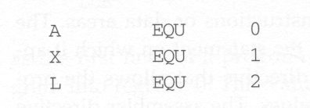
Symbol-Defining Statements
Define mnemonic names for registers:

Slide 13
ORG (origin)
Indirectly assign values to symbols
Reset the location counter to the specified value
ORG value
Value can be:  constant,  other symbol,  expression
No forward reference

Slide 14
ORG (origin)
When this statement is encountered during assembly of a program, the assembler resets its location counter to the specified value.
The ORG statement will thus affect the values of all labels defined until the next ORG.
Normally when an ORG without specified value is encounter, the previously saved location counter value is restored,

Slide 15
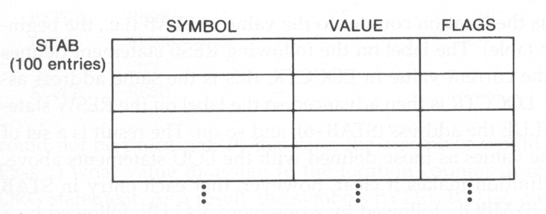
ORG Usage Example
Suppose that we have the following data structure and want to access its fields:

Slide 16

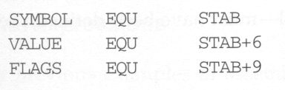
Program without Using ORG
Show offsets, less
readable
We can then use LDA VALUE, X to fetch the VALUE field from the table entry indicated by the content of register X.
To fetch the next record, X is added by 6 + 1 + 2.

Slide 17
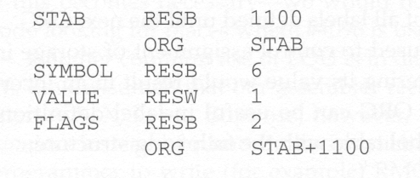
Program with Using ORG
Show sizes, more
readable
Restore the location counter to the old value

Slide 18

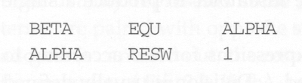
No Forward Reference Allowed
For EQU and ORG, all symbols used on the right hand side of the statement must have been defined previously in the program.
This is because in the two-pass assembler, we require that all symbols must be defined in pass 1.
Allowed
Not allowed

Slide 19
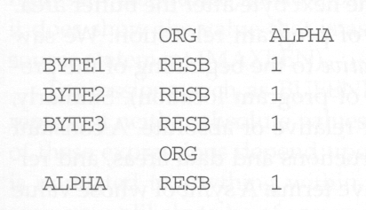
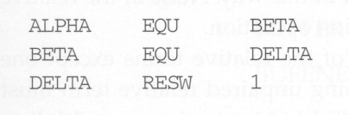
ORG Restriction
Not allowed
Not allowed

Slide 20
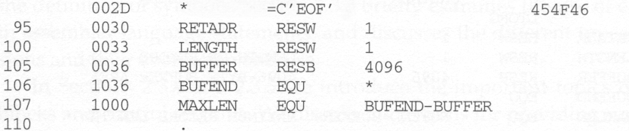
Expression
So far, when we define the value of a symbol or label, only one term is used.
E.g., 106 BUFEND EQU *
Actually, we can also use expressions which contains many terms to define a symbol’s value, evaluated by assembler to produce single operand value or address
E.g., 107 MAXLEN EQU BUFEND - BUFFER

Slide 21
Relative v.s. Absolute Value
Generally, +, -, *, /, operations are allowed to be used in an expression.
Division is defined to produce an integer.
Regarding program relocation, a symbol’s value can be classified as
Relative
Its value is relative to the beginning of the object program, and thus its value is dependent of program location.
E.g., labels or reference to location counter (*)
Absolute
Its value is independent of program location
E.g., a constant.

Slide 22
Relative v.s. Absolute Expression
Depending on the type of value they produce, expressions are classified as:
Absolute
An expression that contains only absolute terms, or
An expression that contains relative terms but the relative terms occur in pairs and the terms in each pair have opposite signs. (/ and * operations are not allowed)
Relative
An expression in which all relative terms except one can be paired as before and the remaining unpaired term must have a positive sign. (/ and * operations are not allowed)

Slide 23
Absolute Expression Example
107 MAXLEN EQU BUFEND – BUFFER
Although BUFEND and BUFFER are relative terms (because their values will change when the program is loaded into a different place in memory), the expression (BUFEND – BUFFER) is an absolute expression.
Why? the value of this expression is 0x1000, which is the same no matter where this program is loaded.
Why? Because BUFEND and BUFFER can be represented as (startingaddr + x) and (startingaddr + y), BUFEND – BUFFER becomes (x – y), which is a constant.

Slide 24
Illegal Expressions
BUFEND + BUFFER
100 – BUFFER
3 * BUFFER
These expressions represent neither absolute nor location within the program
Therefore, these expression are considered illegal.

Slide 25
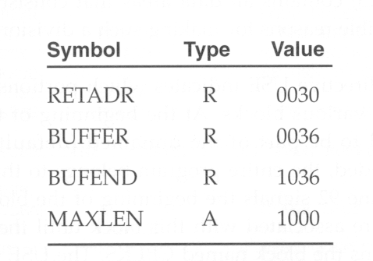
Enhanced Symbol Table
To determine the type of an expression, we must keep track of the types of all symbols defined in the program,
Therefore, we need a flag in the symbol table to indicate type of value (absolute or relative) in addition to the value itself.
Easily determine the type of expression and generate M record in object program for relative values

Slide 26
Program Blocks
Program blocks
refer to segments of code that are rearranged within a single object program unit
USE [blockname]
Default block
Example: Figure 2.11
Each program block may actually contain several separate segments of the source program

Slide 27
Program Blocks - Implementation
Pass 1
each program block has a separate location counter
each label is assigned an address that is relative to the start of the block that contains it
at the end of Pass 1, the latest value of the location counter for each block indicates the length of that block
the assembler can then assign to each block a starting address in the object program
Pass 2
The address of each symbol can be computed by adding the assigned block starting address and the relative address of the symbol to that block

Slide 28
Figure 2.12
Each source line is given a relative address assigned and a block number(end of pass1)
For absolute symbol, there is no block number
line 107
Example
20 0006 0 LDA LENGTH 032060
LENGTH=(Block 1)+0003= 0066+0003= 0069
LOCCTR=(Block 0)+0009= 0009

Slide 29
Program Readability
Program readability
No extended format instructions on lines 15, 35, 65
No needs for base relative addressing (line 13, 14)
LTORG is used to make sure the literals are placed ahead of any large data areas (line 253)
Object code
It is not necessary to physically rearrange the generated code in the object program
see Fig. 2.13, Fig. 2.14

Slide 30
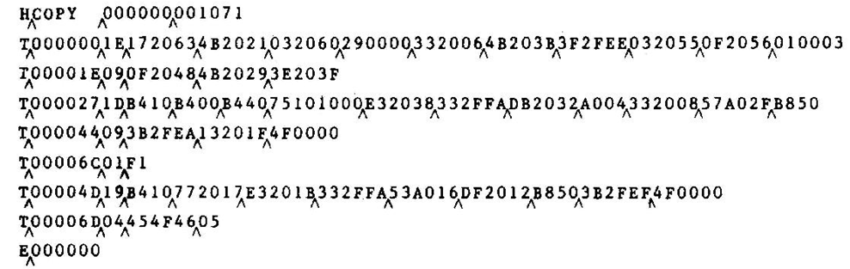
Object Program

Slide 31
Control Sections and Program Linking
Control Sections
are most often used for subroutines or other logical subdivisions of a program
the programmer can assemble, load, and manipulate each of these control sections separately
instruction in one control section may need to refer to instructions or data located in another section
because of this, there should be some means for linking control sections together
Fig. 2.15, 2.16

Slide 32
External Definition and References
External definition
EXTDEF name [, name]
EXTDEF names symbols that are defined in this control section and may be used by other sections
External reference
EXTREF name [,name]
EXTREF names symbols that are used in this control section and are defined elsewhere
Example
15 0003 CLOOP +JSUB RDREC 4B100000
160 0017 +STCH BUFFER,X 57900000
190 0028 MAXLEN WORD BUFEND-BUFFER 000000

Slide 33
Implementation
The assembler must include information in the object program that will cause the loader to insert proper values where they are required
Define record
Col. 1 D
Col. 2-7 Name of external symbol defined in this control section
Col. 8-13 Relative address within this control section (hexadecimal)
Col.14-73 Repeat information in Col. 2-13 for other external symbols
Refer record
Col. 1 D
Col. 2-7 Name of external symbol referred to in this control section
Col. 8-73 Name of other external reference symbols

Slide 34
Modification Record
Col. 1 M
Col. 2-7 Starting address of the field to be modified (hexadecimal)
Col. 8-9 Length of the field to be modified, in half-bytes (hexadecimal)
Col.11-16 External symbol whose value is to be added to or subtracted from the indicated field
Note: control section name is automatically an external symbol, i.e. it is available for use in Modification records.
Example
Figure 2.17
M00000405+RDREC
M00000705+COPY

Slide 35
External References in Expression
Earlier definitions
required all of the relative terms be paired in an expression (an absolute expression), or that all except one be paired (a relative expression)
New restriction
Both terms in each pair must be relative within the same control section
Ex: BUFEND-BUFFER
Ex: RDREC-COPY
In general, the assembler cannot determine whether or not the expression is legal at assembly time. This work will be handled by a linking loader.

Slide 36
Assembler Design Options
One-pass assemblers
Multi-pass assemblers
Two-pass assembler with overlay structure

Slide 37
Two-Pass Assembler with Overlay Structure
For small memory
pass 1 and pass 2 are never required at the same time
three segments
root: driver program and shared tables and subroutines
pass 1
pass 2
tree structure
overlay program

Slide 38
One-Pass Assemblers
Main problem
forward references
data items
labels on instructions
Solution
data items: require all such areas be defined before they are referenced
labels on instructions: no good solution

Slide 39
One-Pass Assemblers
Main Problem
forward reference
data items
labels on instructions
Two types of one-pass assembler
load-and-go
produces object code directly in memory for immediate execution
the other
produces usual kind of object code for later execution

Slide 40
Load-and-go Assembler
Characteristics
Useful for program development and testing
Avoids the overhead of writing the object program out and reading it back
Both one-pass and two-pass assemblers can be designed as load-and-go.
However one-pass also avoids the over head of an additional pass over the source program
For a load-and-go assembler, the actual address must be known at assembly time, we can use an absolute program

Slide 41
Forward Reference in One-pass Assembler
For any symbol that has not yet been defined
1. omit the address translation
2. insert the symbol into SYMTAB, and mark this symbol undefined
3. the address that refers to the undefined symbol is added to a list of forward references associated with the symbol table entry
4. when the definition for a symbol is encountered, the proper address for the symbol is then inserted into any instructions previous generated according to the forward reference list

Slide 42
Load-and-go Assembler (Cont.)
At the end of the program
any SYMTAB entries that are still marked with * indicate undefined symbols
search SYMTAB for the symbol named in the END statement and jump to this location to begin execution
The actual starting address must be specified at assembly time
Example
Figure 2.18, 2.19

Slide 43
Producing Object Code
When external working-storage devices are not available or too slow (for the intermediate file between the two passes
Solution:
When definition of a symbol is encountered, the assembler must generate another Text record with the correct operand address
The loader is used to complete forward references that could not be handled by the assembler
The object program records must be kept in their original order when they are presented to the loader
Example: Figure 2.20

Slide 44
Multi-Pass Assemblers
Restriction on EQU and ORG
no forward reference, since symbols’ value can’t be defined during the first pass
Example
Use link list to keep track of whose value depend on an undefined symbol
Figure 2.21

Slide 45
End of Chapter 03

